Slide 1
GIDS Masters Admissions Project: Final Presentation
Team 10: Qianqian Gu, Chen Yao, Hanyang Zhang, Wei Wu

Slide 2
Agenda
Introduction
Dataset Description
Project Vision and Goals
Progress on Milestones
Part I. Analysis
Part II. Analysis

Slide 3
Introduction
Project Sponsor:
Lisa Altman & Gretchen Briscoe
Academic Advisor:
Prof. Ajay Anand
Team Members:
Qianqian Gu (Project Manager)
Chen Yao
Hanyang Zhang
Wei Wu
Expected Delivery:
May 1st, 2022

Slide 4
Dataset Description
6-year GIDS Applicant Data (2015-2021)
Over 3,700 rows
Around 200 columns
Demographic data (i.e., age, citizenship, sex, etc.)
Academic data (i.e., GRE test score, GPA, etc.)
Application timeline (i.e., application created time, etc.)
National Student Clearinghouse Data (2013-2018)
It documented which school and program a person enrolled in
Can be joined with the GIDS applicant data by unique slate reference number

Slide 5
Project Vision
Part # 1: Applicant Decisions
To better understand the applicant pool
To understand which programs are main competitors of the programs GIDS offers
To assist in marketing and future recruitment
To predict which applicants will accept the offer
Part # 2: Understanding Application Cycles
To better understand application cycles
To better understand the applicant pool
To assist in marketing and future recruitment
To assist our program on how to predict workload

Slide 6
Project Goals
Stage 1: Data Acquisition & Cleaning
Stage 2: Data Exploration & Classification
Stage 3: Data Visualization
Stage 4: Prediction Models and Algorithms
Stage 5: Final Report with Suggestions on Future Marketing/Recruitment

Slide 7
Progress on Milestones
Task | Target Date | Actual Date | Status
Completed the project charter and started data pre-processing | Feb 28, 2022 | Feb 28, 2022 | Complete
Completed data cleaning and explored data through visualizations | Mar 12, 2022 | Mar 15, 2022 | Complete
Completed descriptive analyses and answered the questions as many as possible | Mar 28, 2022 | Mar 30, 2022 | Complete
Trained and tested prediction models; re-trained if the accuracy rates didn’t meet expectations | April 15, 2022 | April 18, 2022 | Complete
Completed the final presentation and the final report | April 27, 2022 |  | In Progress

Slide 8
Part I. Applicant Decisions

Slide 9
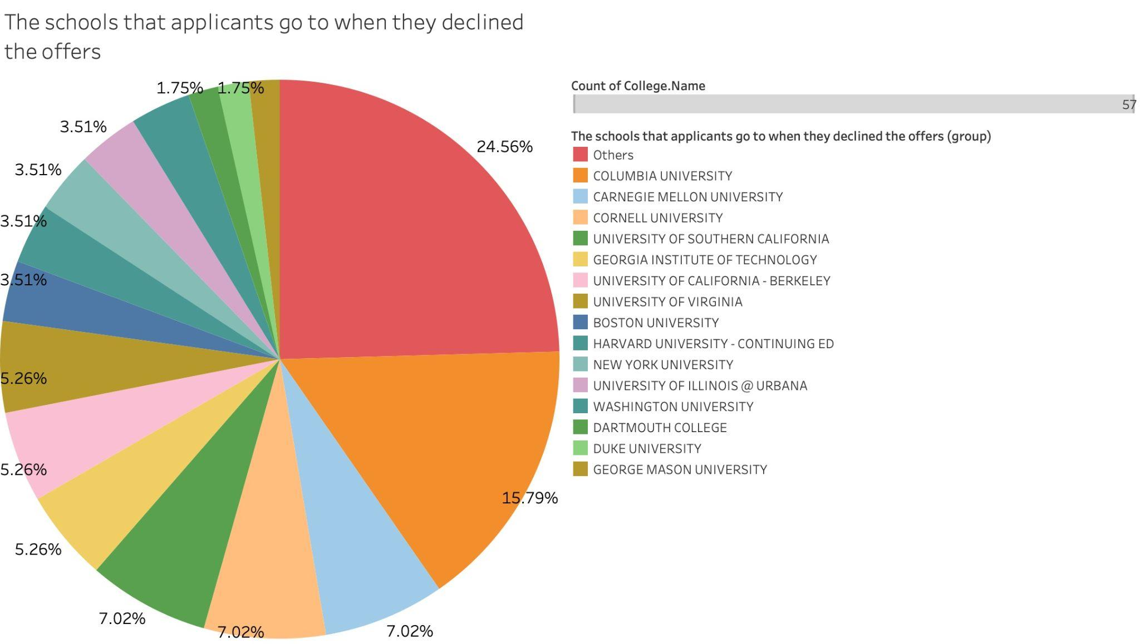
Where did our admitted applicants go if they didn’t choose Rochester?
Descending order
More admitted students who decline our offers seem to go to school such as Columbia University, Carnegie Mellon University, and Cornell University.

Slide 10
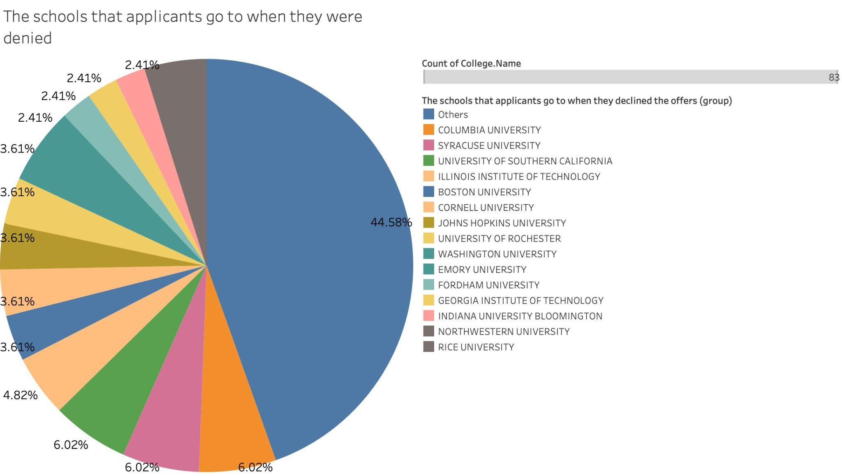
Where did denied/waitlisted applicants go if they didn’t get admitted to Rochester?
Descending order
More admitted students who didn’t get admitted to Rochester seem to go to school such as Columbia University, Syracuse University, and University of Southern California.

Slide 11
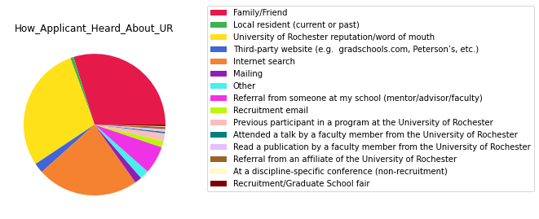
How did they hear about our program?
Order the legend categorical based on the percentage of distribution of each category
Most students heard about our program through Family/Friend, Internet search, and University of Rochester’s reputation/word of mouth (higher percentage).

Slide 12
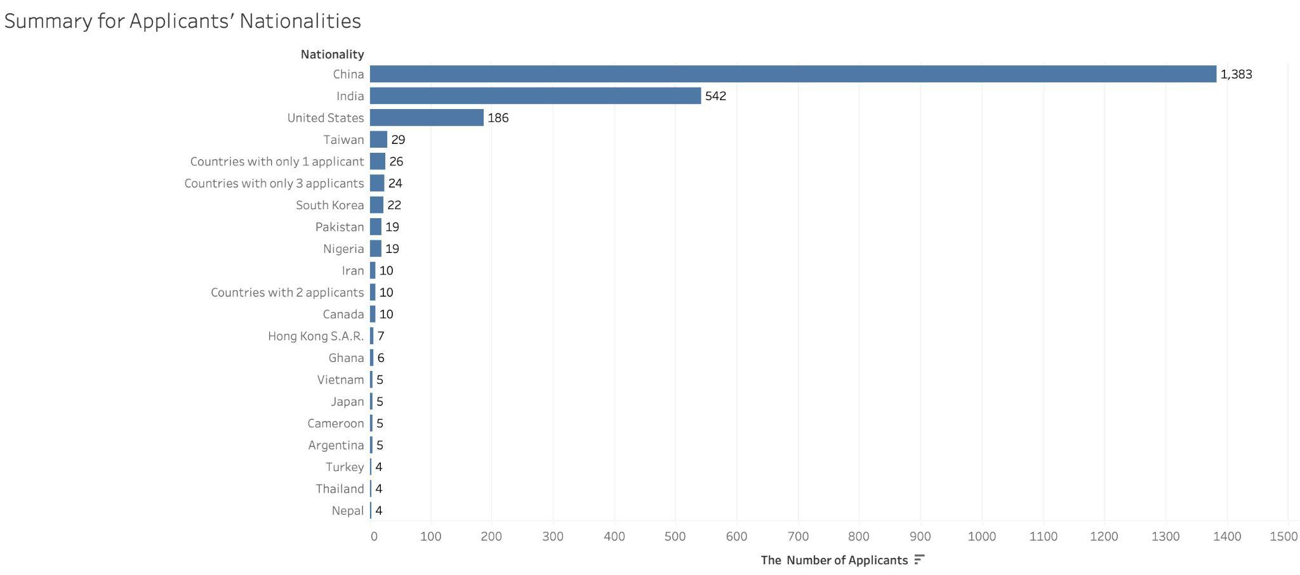
Part I: The nationalities of our applicants
More graduate school applicants are from China, India, and United States.

Slide 13
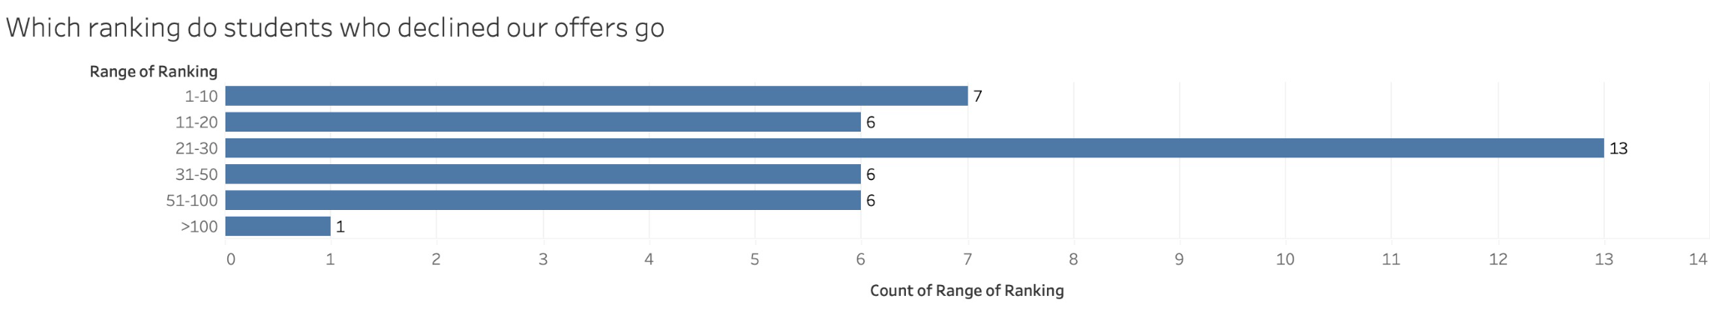
The ranking of students who declined our offers.
Since University of Rochester is currently ranked as no.34 in US news, it is likely that more rankings of students who declined our offers are in the range from 21 - 30.

Slide 14
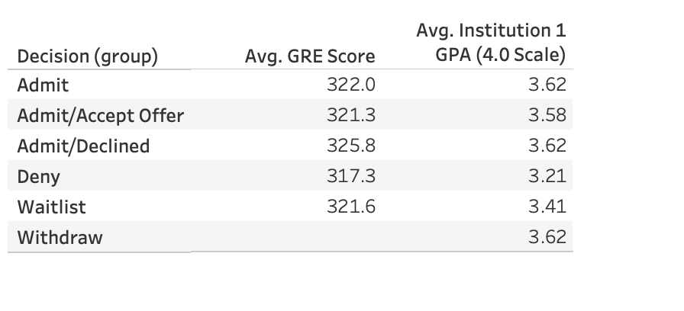
Average GPA and GRE scores of different groups
Avg.GRE Score and Avg.GPA of students who decline our offers are higher than those that accept our offers (ex: more applicants who decline out offers go to columbia university which has higher rankings).
Avg.GRE Score and Avg.GPA of students who denied are lower.

Slide 15
Part I: Methods
(Predicting whether a student will decline our offer)
Accept : Class 0
Decline(Melt, No response, Decline, Defer): Class 1
Deny: eliminated

Slide 16
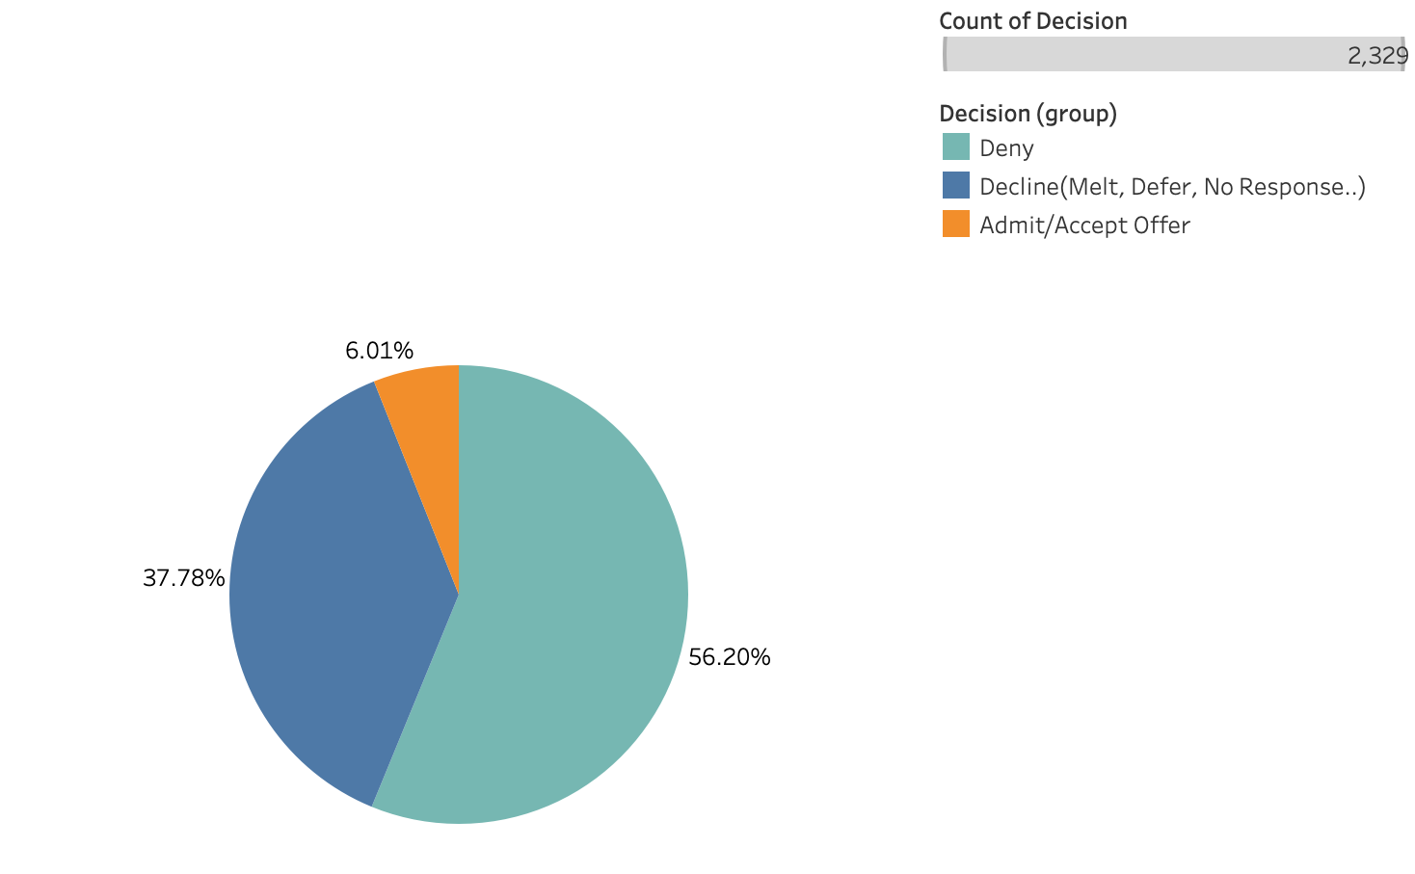
Part I: Methods (Distri. Of Original Target Column )

Slide 17
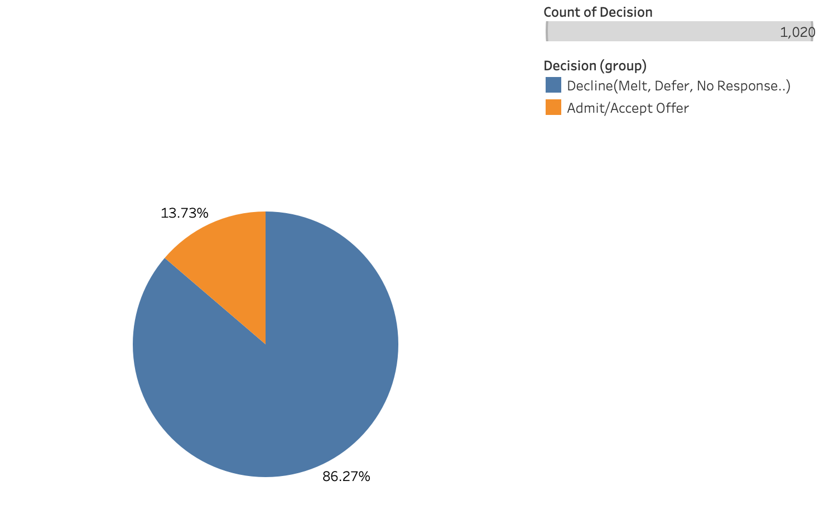
Part I: Methods (Distri. After Elimination)

Slide 18
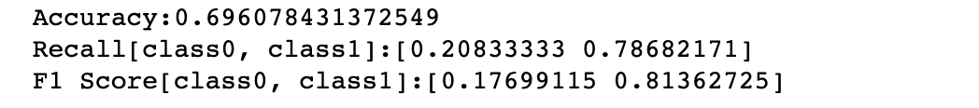
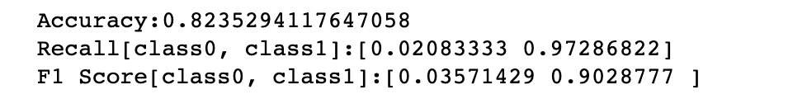
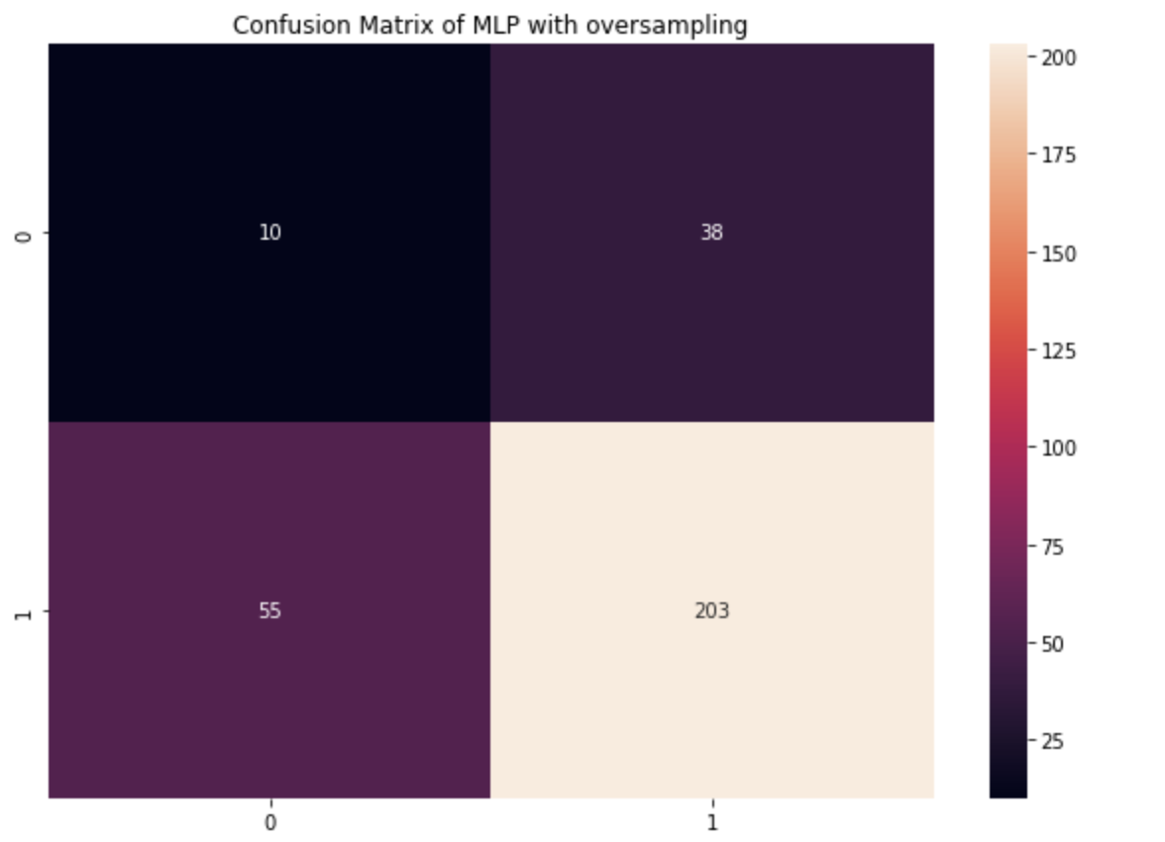
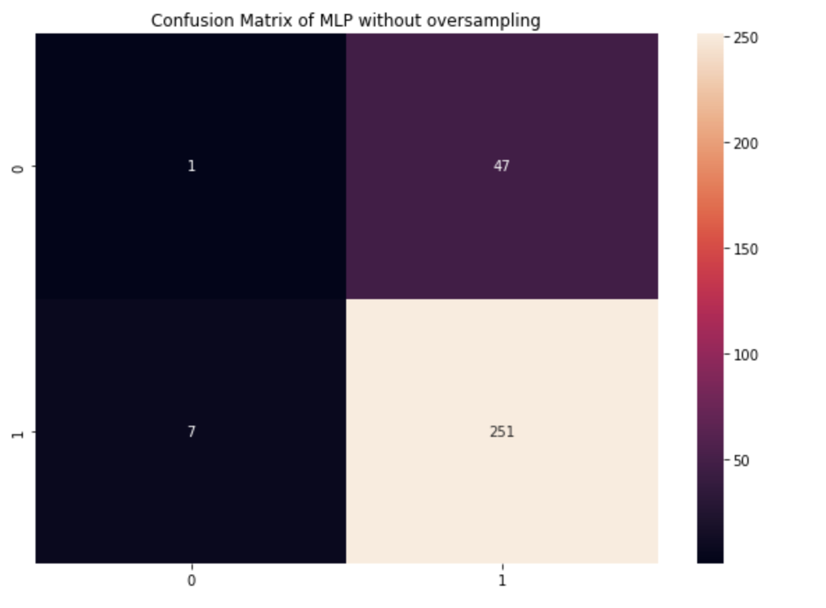
Part I: Methods (MLP)

Slide 19
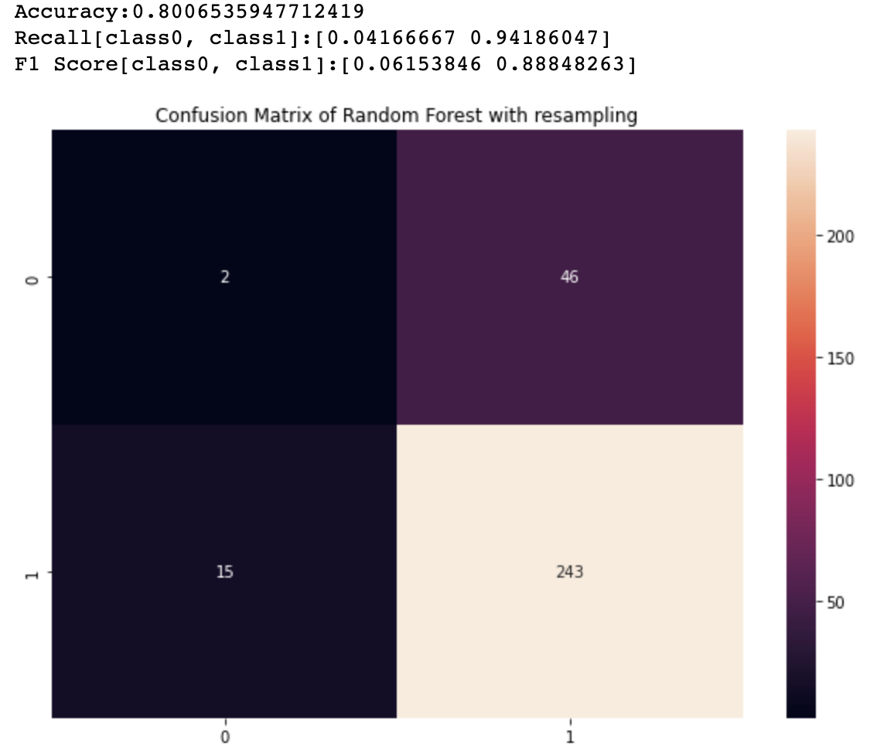
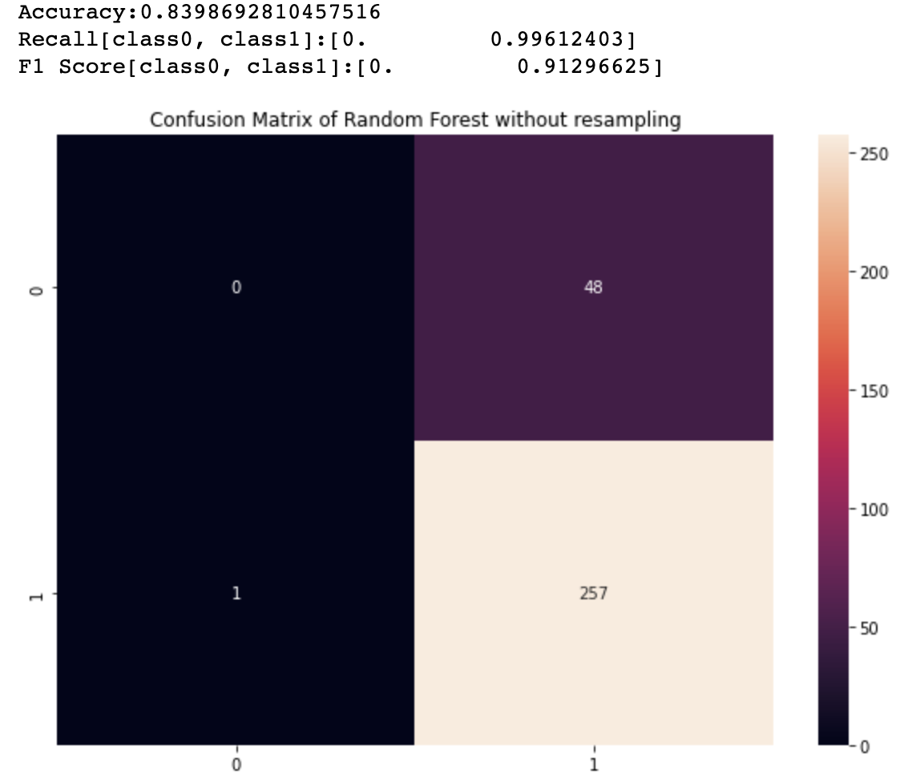
Part I: Methods(Random Forest)

Slide 20
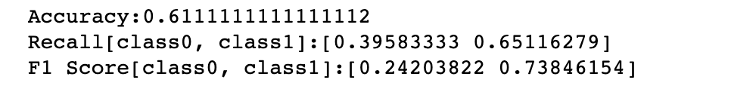
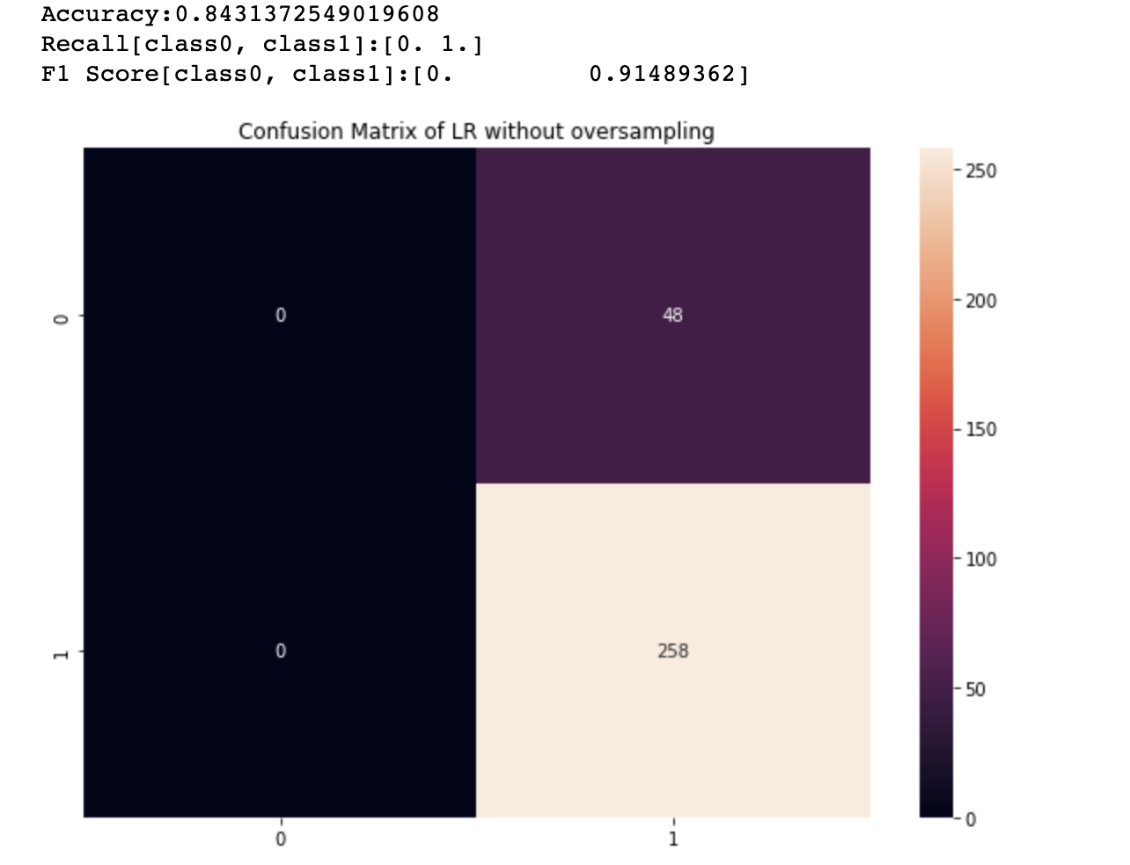
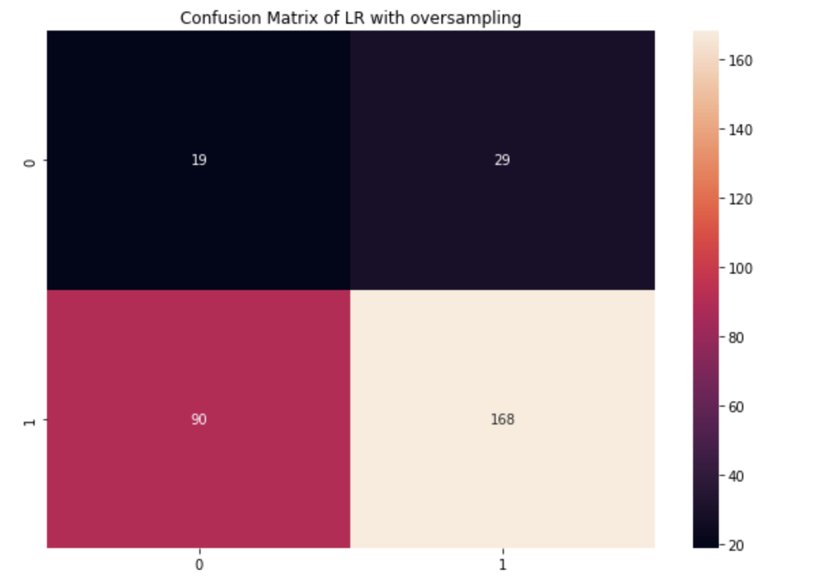
Part I: Methods (Logistic Regression)

Slide 21
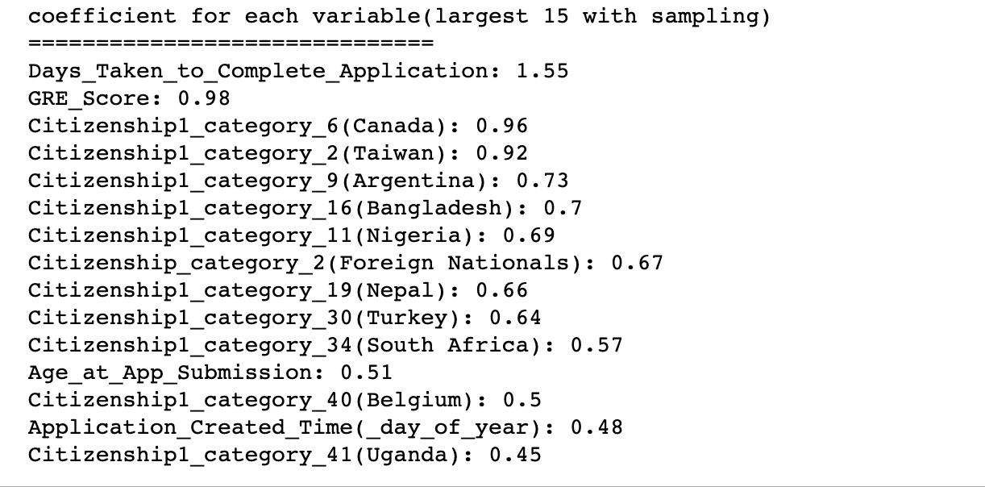
Part I: Methods (Logistic Regression) with oversampling

Slide 22
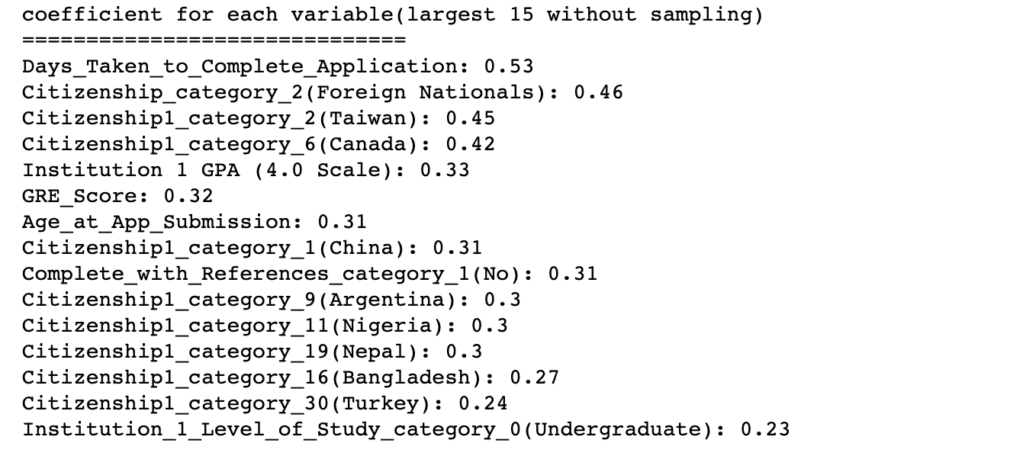
Part I: Methods (Logistic Regression) without oversampling

Slide 23
Part I: Model Information
Recall and F1 Score are in format of [class0,class1] | Accuracy | Recall | F1 score | Accuracy | Recall | F1 score
 | Without Oversampling |  |  | With Oversampling
Logistic Regression | 0.8431 | [0,1] | [0,0.91] | 0.6111 | [0.40,0.65] | [0.24,0.74]
Random Forest | 0.8400 | [0,0.99] | [0,0.91] | 0.8006 | [0.04,0.94] | [0.06,0.89]
MLP | 0.8235 | [0.02,0.97] | [0.04,0.90] | 0.6960 | [0.21,0.79] | [0.18,0.81]

Slide 24
Part II. Application Cycles

Slide 25
Part II: Achievements
For part 2 which focuses on application cycle, we divide the instructed questions into two parts:
Procrastination vs. Decision(Students/School)
Trend/Cycle of application
Start time Complete
Complete vs. Incomplete
Submission vs. Complete

Slide 26
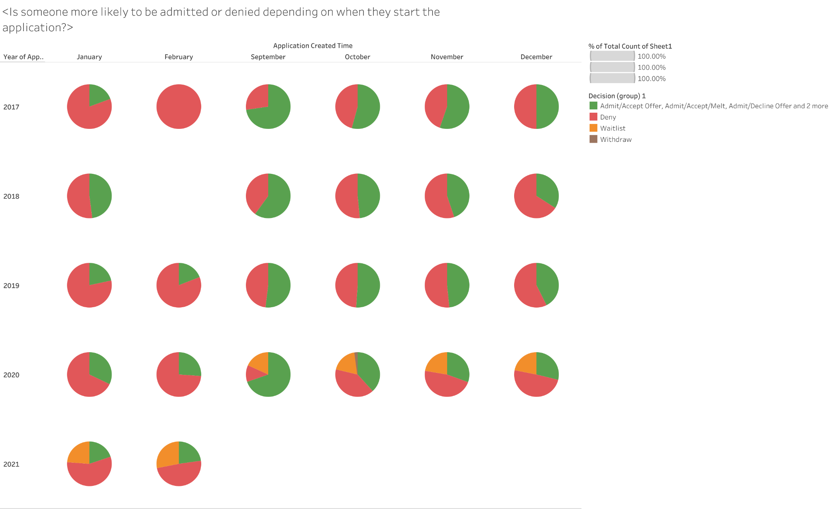
The Admit section tends to shrink in the later part of fall admission cycle for started time.
Indication of more prepared time relates to success

Slide 27
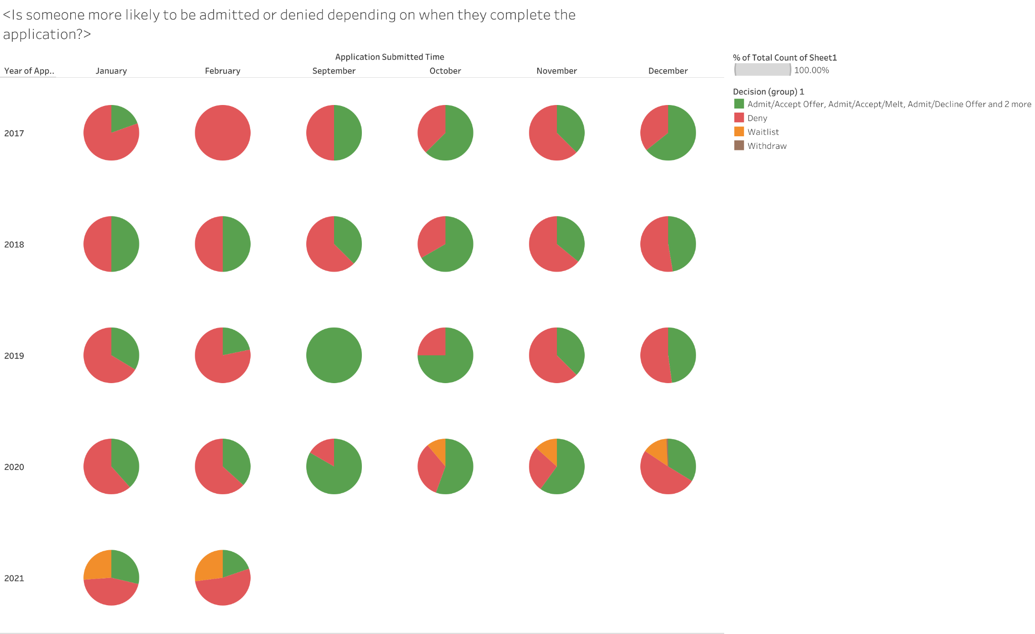
The Admit section also tends to shrink in the later part. This characteristic tends to become more apparent in recent year.

Slide 28
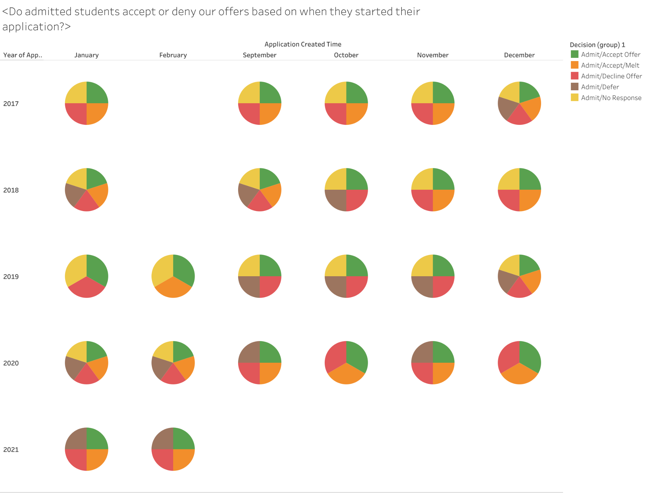
There is no obvious pattern of portion of student decision vs. started time. But for 2020-2021 cycle, there is no no response decision.

Slide 29
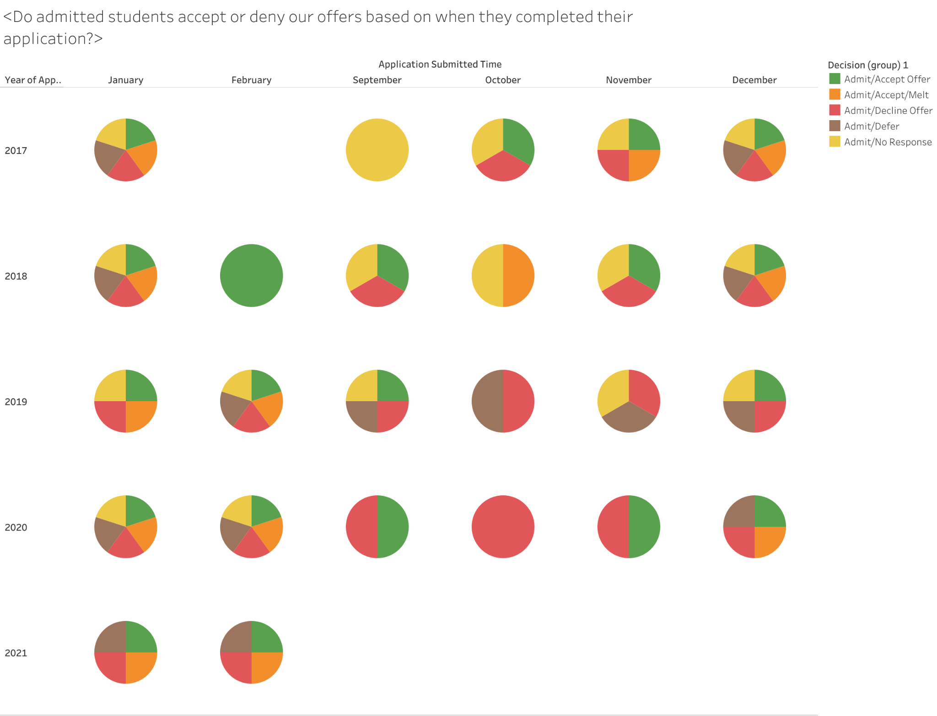
Not able to see a clear pattern based on the submission time, but for later submission time in a specific cycle, the decision tends to become more mixed. - perhaps due to larger volume of applications.

Slide 30
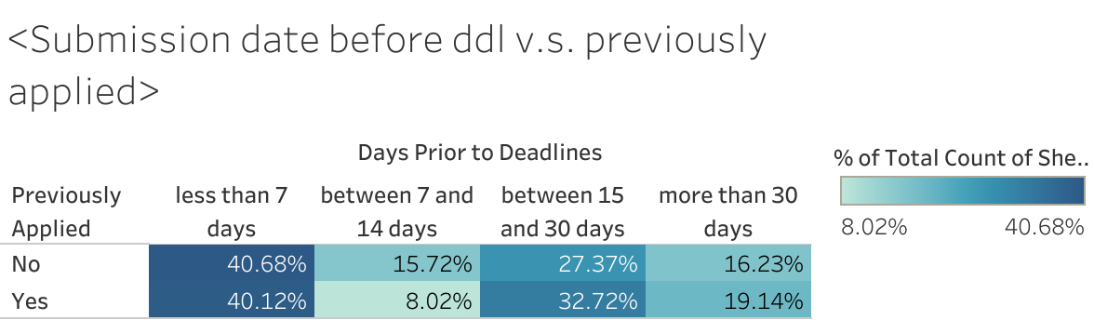
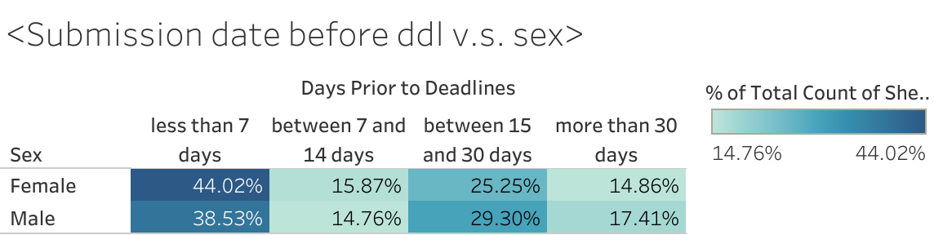
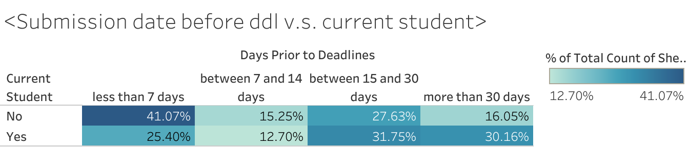
When comparing with if a student has previously applied, sex, and current student or not, we found most student are still in the same range.

Slide 31
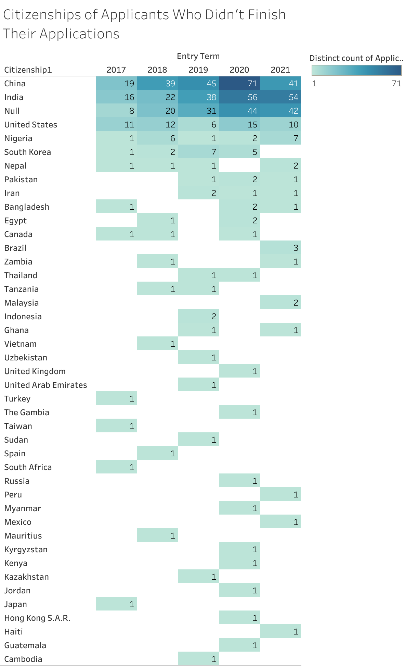
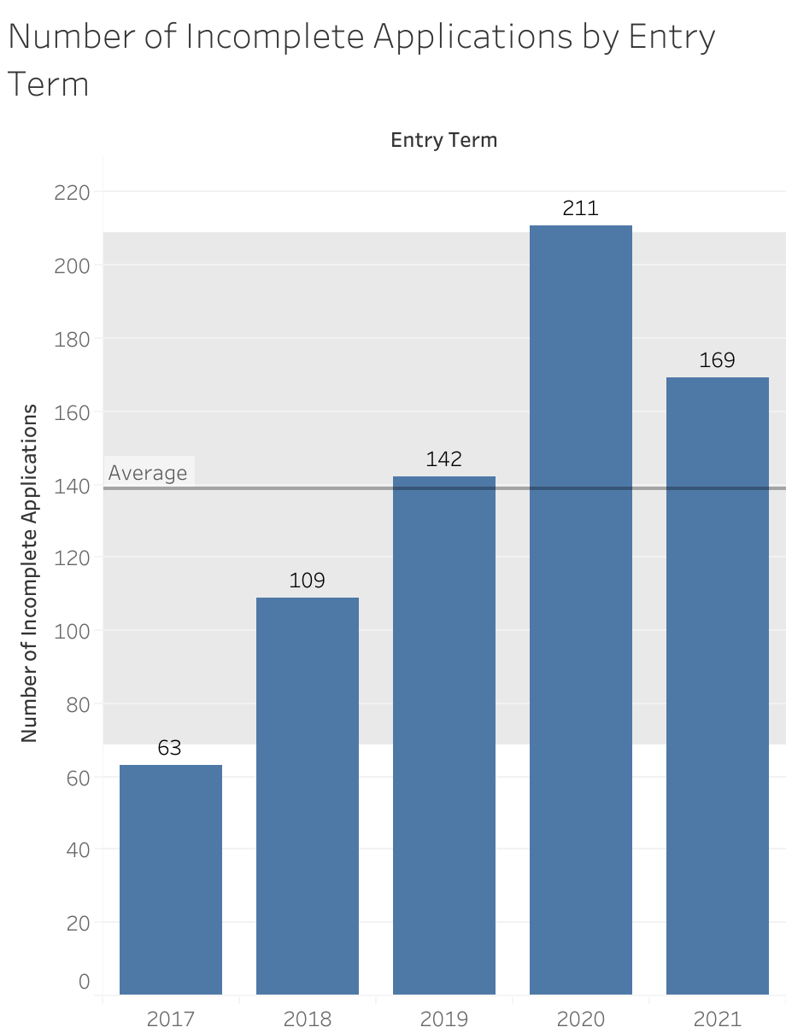
Insights on Incomplete Application

Slide 32
The Last Question
“Based on the number of people who start applications on a certain week, can you predict how many applicants will complete?”
Prediction models?
Empirical Analysis

Slide 33
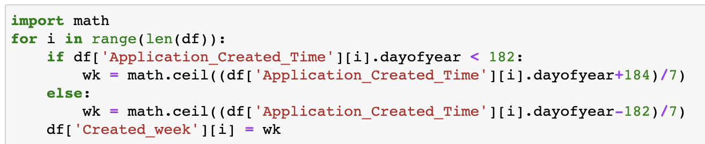
New variable Created_week
We found that for each term, the application opening date varies. We took July 1st as the average application opening date and applied it to each entry term. We created new variable of ‘Created_week’ under the assumption that there are 182 days before July 1st, and 184 days after July 1st for each year. Now we can measure in which week each applicant creates his or her application after the application is opened

Slide 34
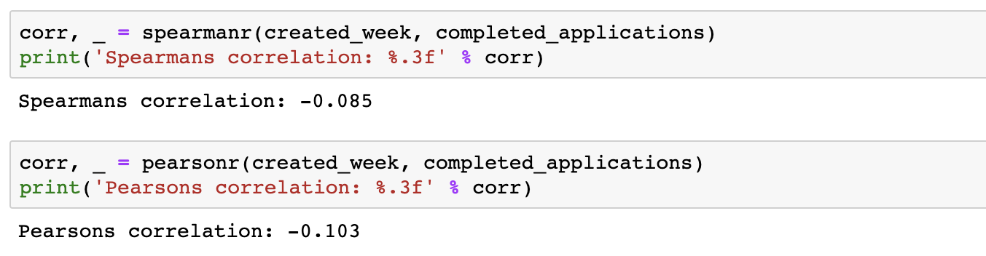
Correlation Results
Two correlation tests of created_week and the target variable

Slide 35
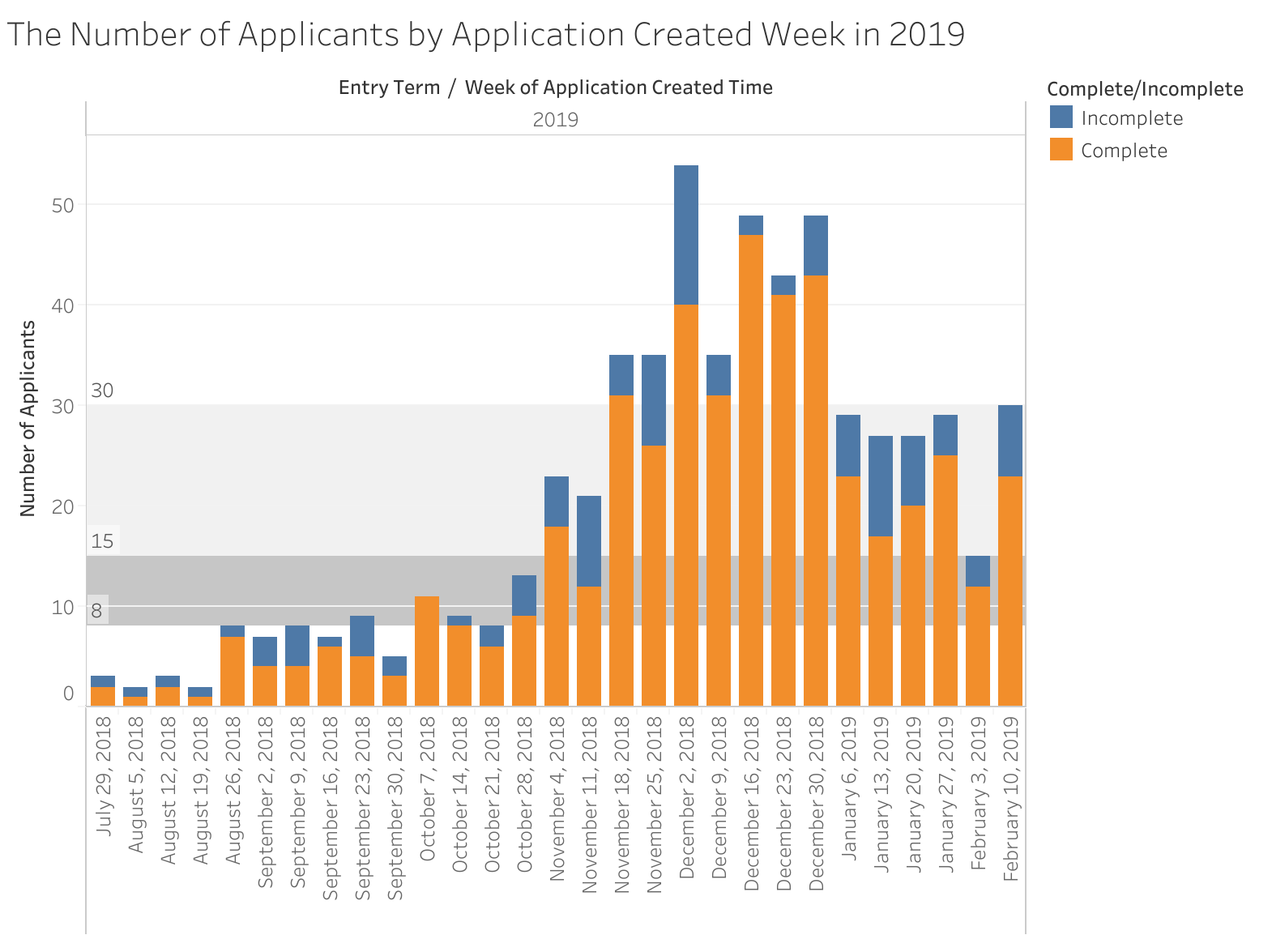
In 2019, the application cycle consists of 29 weeks
The majority of applications were created during 7 successive weeks
Notes:
The quartile measures the spread of values above and below the mean by dividing the distribution into four groups.
A quartile divides data into three points—a lower quartile, median, and upper quartile—to form four groups of the dataset.
If there are more than 30 applications created on a certain week, then that week has more applications coming in than at least 75% of all weeks

Slide 36
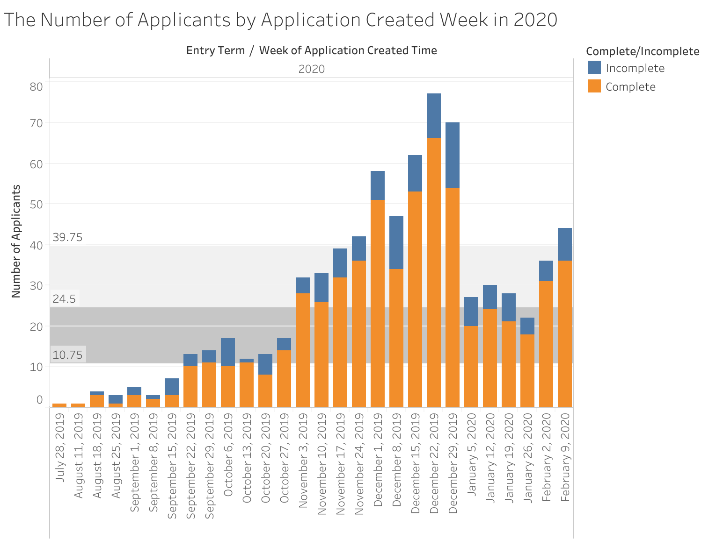
In 2020, the application cycle consists of 28 weeks
The majority of applications were created during 7 successive weeks

Slide 37
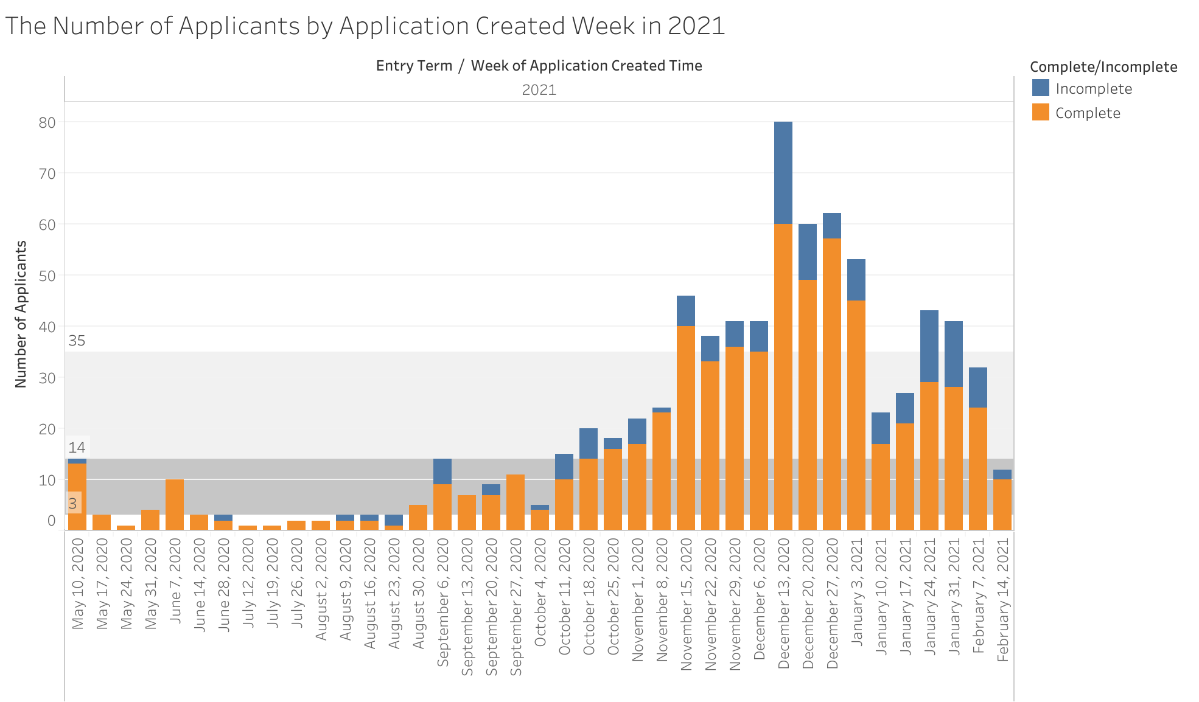
In 2021, the application cycle consists of 39 weeks
The majority of applications were created during 8 successive weeks

Slide 38
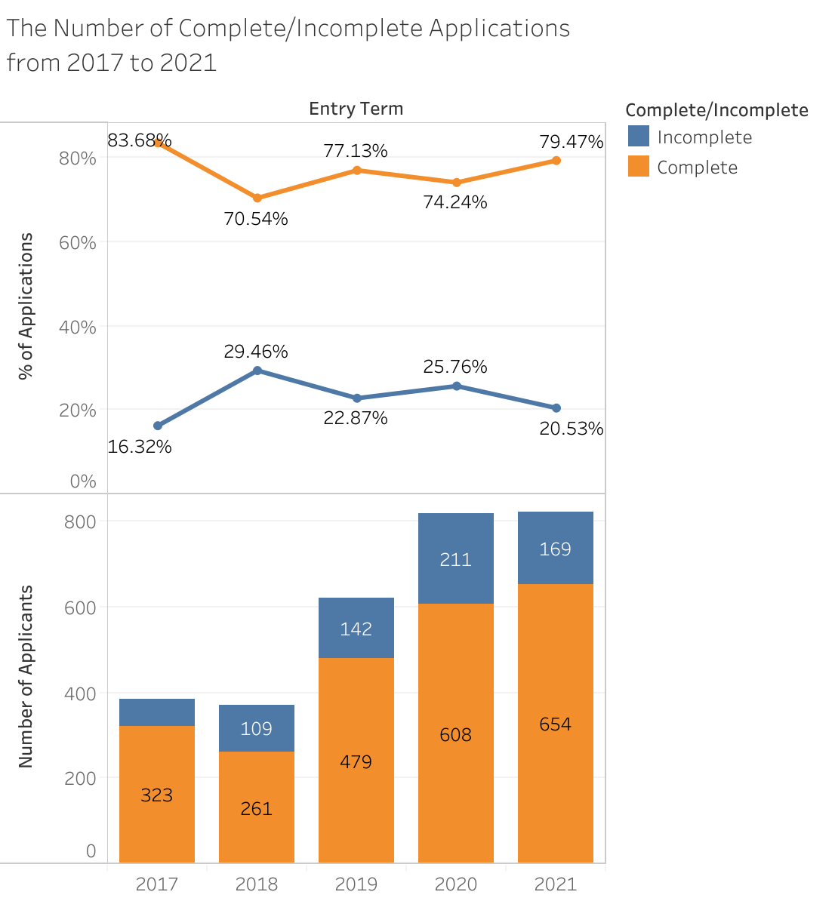
Key Insights
On average, around 23% of applications were incomplete/not submitted, regardless of the application created week
Given the priority deadline (Jan 5) and the normal deadline (Feb 15) stay constant, the number of applications created usually reaches the peak between mid November and the end of December

Slide 39
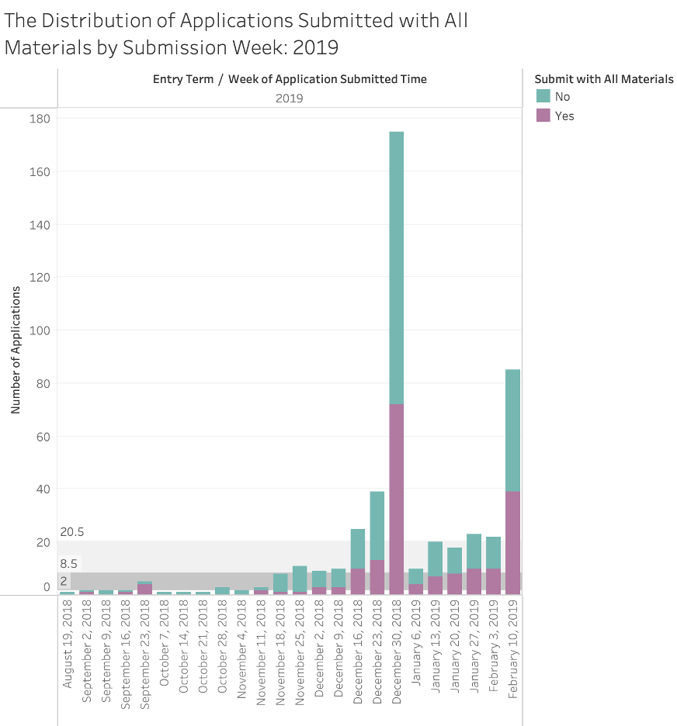
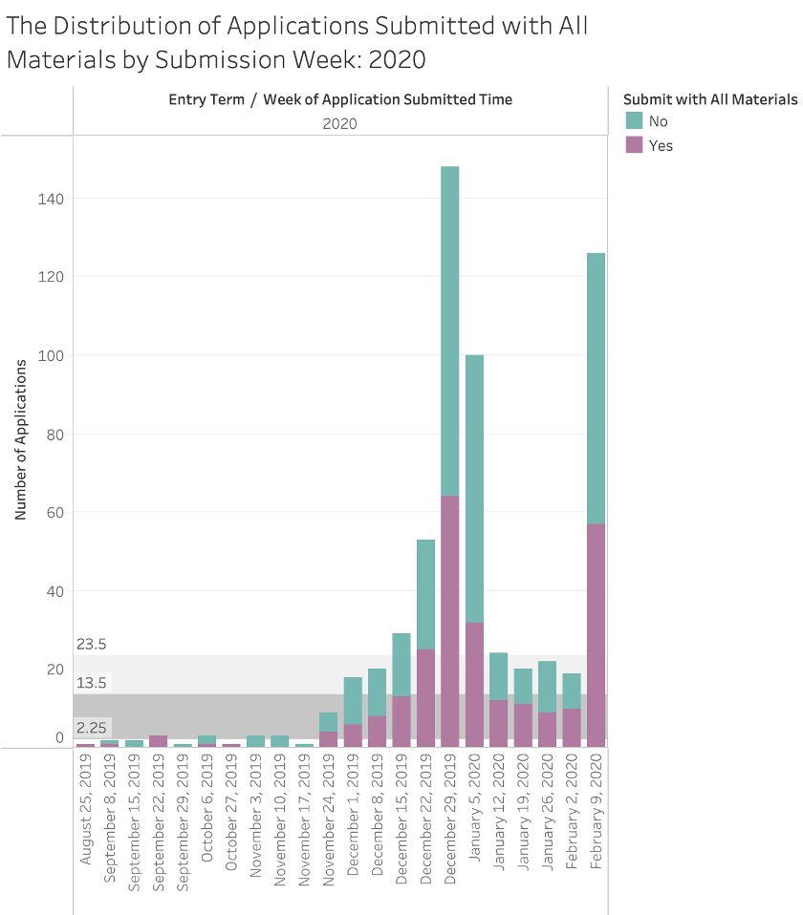

Slide 40
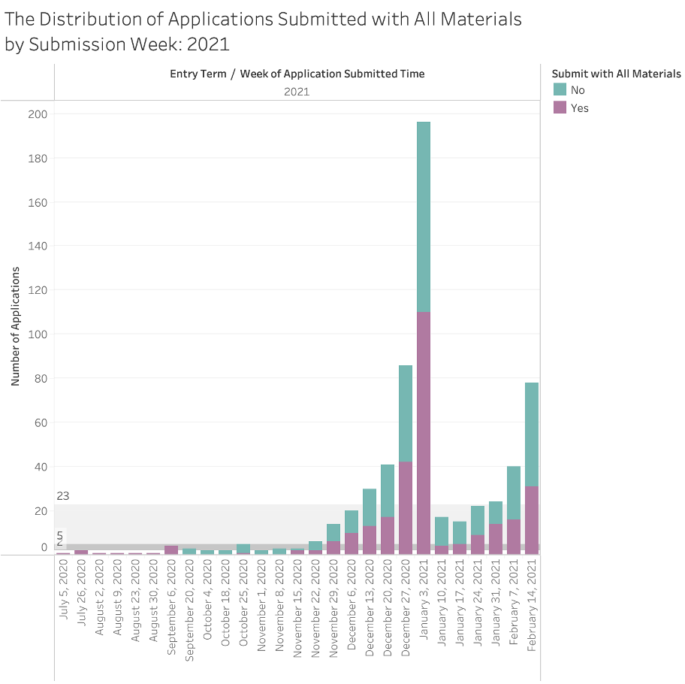
Around 55% of applications were submitted without all recommendation letters and GRE score ready
Most applications were submitted within 3 weeks prior to the deadline, normally mid December to early January

Slide 41
Conclusions
Students who started applications early are more likely to get admitted
Students who took more time to complete their applications and had higher GRE scores are more likely to decline the offer
No obvious pattern between start time/submission time and student’s decision
No strong correlation between application created week and application completion status
When applicants submitted their applications, half of them didn’t have all required materials ready

Slide 42
Challenges
The small size of dataset
The imbalance of records (i.e., accept vs. decline, incomplete vs. complete)
Excessive null values

Slide 43

Next Steps
To generate insights and suggestions for future marketing and recruitment
To consolidate results and complete the final report

Slide 44
Acknowledgements
Thanks for Ms. Altman, Ms. Briscoe, and Prof. Ajay!

Slide 45
Questions?

Slide 46
Thank you for listening!

